Slide 1
Big Data

Slide 2
What is BIG Data ?
Huge volume of data ( Terabytes or Petabytes)
Big Data is the term for a collection of data sets so large and complex that it becomes difficult to process using on-hand database management tools or traditional data processing applications.
The challenges includes capture, storage, search, sharing, transfer, analysis and visualization.
Huge amount of data generated from internet, social network, machines – so the question arises how to store the data and process the data.
Handles Structured, Semi Structured, Unstructured data

Slide 3
Introduction
Google file system >>>> HDFS
Mapreduce >>>>> Mapreduce
BigTable >>>>> Apache Hbase
Data Handled in Form of :
Structured: Organised data format with a fixed schema.
Ex: RDBMS
Semi-Structured: Partially organised data which does not have a fixed format.
Ex: XML, JSON
Unstructured: Unorganised data with an unknown schema.
Ex: Audio, video files etc.

Slide 4
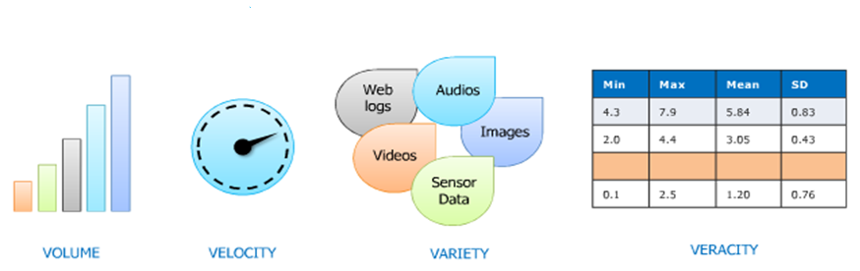
Definition of BIG data : 4 V’s

Slide 5
Big Data Analytics:
Big Data Analytics is largely used by companies to facilitate their growth and development.
There are multiple tools for processing Big Data such as :
Hadoop
Pig
Hive
Cassandra
Spark
Kafka etc.

Slide 6
Big Data Applications:
Big Data Applications: Healthcare
Big data analytics have improved healthcare by providing personalized medicine and prescriptive analytics.
Researchers are mining data to see what treatments are more effective for particular conditions, identify patterns related to drug side effects, and gains other important information that can help patients and reduce costs.

Slide 7
Big Data Applications:
Big Data Applications: Manufacturing
Major benefits of using Big Data applications in manufacturing industry are:
Product quality and defects tracking
Supply planning
Manufacturing process defect tracking
Output forecasting
Increasing energy efficiency
Testing and simulation of new manufacturing processes
Support for mass-customization of manufacturing

Slide 8
Big Data Applications:
Big Data Applications: Media & Entertainment
Various companies in the media and entertainment industry are facing new business models, for the way they – create, market and distribute their content.
Big Data applications benefits media and entertainment industry by:
Predicting what the audience wants
Scheduling optimization
Increasing acquisition and retention
Ad targeting
Content monetization and new product development

Slide 9
Big Data Applications:
Crime Prediction and Prevention
Police departments can leverage advanced, real-time analytics to provide actionable intelligence that can be used to understand criminal behavior.
Identify crime/incident patterns
Uncover location-based threats.

Slide 10
Big Data Applications:
Big Data Applications: Internet of Things (IoT)
Data extracted from IoT devices provides a mapping of device inter-connectivity.
Such mappings have been used by various companies and governments to increase efficiency.
IoT is also increasingly adopted as a means of gathering sensory data, and this sensory data is used in medical and manufacturing contexts.
Cyber security & Intelligence
The federal government launched a cyber security research and development plan that relies on the ability to analyze large data sets in order to improve the security of U.S. computer networks.
The National Geospatial-Intelligence Agency is creating a “Map of the World” that can gather and analyze data from a wide variety of sources such as satellite and social media data. It contains a variety of data from classified, unclassified, and top-secret networks.

Slide 12

What is Hadoop ?
Apache Hadoop is a framework that allows for the distributed processing of large data sets across clusters of commodity computers using a simple programming model.
It is an open source Data management with scale-out storage and distributed processing.
Distributes processing
Large dataset
Clusters
Commodity computer
Simple programming model
Open source data management
Scale out storage

Slide 13
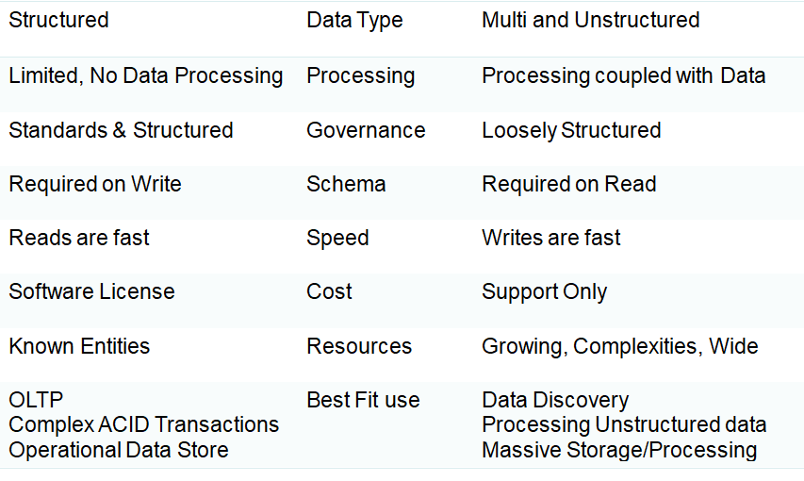
RDBMS and Hadoop

Slide 14
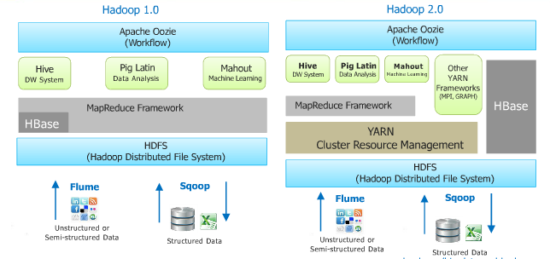
Hadoop Ecosystems :

Slide 15
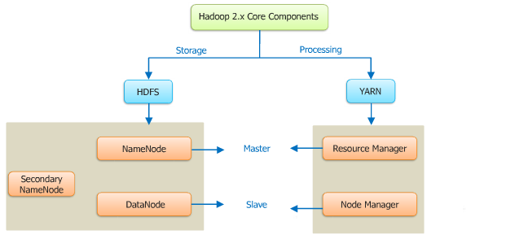
Hadoop Core Components :
Storage :
Identify the machine where data needs to be stored
2. Store the data
Maintain metadata about the storage
Processing :
1. Identify the machine where processing needs to take place
2. Actual execution of the program
3. Monitor for failure/restart of the program

Slide 16
Hadoop Core Components :
NameNode vs. Datanode
Namenode:
Master of System
Maintains and manages the block which are present on the datanode
DataNode:
Slaves which are deployed on each machine and provide the actual storage
Responsible for serving read and write requests for the client

Slide 17
Essential components of Hadoop
HDFS is a Java-based file system that provides scalable and reliable data storage, and it was designed to span large clusters of commodity servers.
Hive provides a database query interface to Apache Hadoop.
Sqoop is a tool designed for efficiently transferring bulk data between Apache Hadoop and structured data-stores such as relational databases.
Flume is a distributed, reliable, and available service for efficiently collecting
Oozie is a workflow scheduler system to manage Apache Hadoop jobs
Hue is a set of web applications that enable you to interact with a CDH cluster.

Slide 19
Introduction to HDFS
HDFS is a Java-based file system that provides scalable and reliable data storage, and it was designed to span large clusters of commodity servers
HDFS: Scalable, Reliable, Manageable and Economical
Very large distributed file system
50K nodes, 100 billion files, Multi PB (Not a hard limit. Fully scalable).
Highly scalable
Add commodity servers and disks to scale storage and IO bandwidth.
Supports large files (in GBs or TBs).
The number of nodes in a cluster is not constant.
Bandwidth scales linearly with the number of nodes and disks.

Slide 20
Introduction to HDFS
Reliable
In a large cluster, something is always broken.
Nodes fail every day. Failure is expected, rather than exception.
Engineering reliability into every app is expensive.
Fault tolerant and easy management
Every block is replicated.
Disk corruption and node failures are internally handled.
Node addition/removal is done automatically.
Every 3K nodes managed by one operator.

Slide 21
Introduction to HDFS
Economical
Use commodity components when possible.
Thousands of these put into an effective compute and storage platform.
Minimizes bandwidth consumption and latency
Satisfies a read request from replica closest to the reader (on the same rack).
If the cluster has multiple data centers then local replica is preferred over remote replica.
Optimized for batch processing

Slide 22
Goals of HDFS
Highly fault-tolerant
Runs on commodity HW, which can fail frequently.
High throughput of data access
Streaming access to data.
Large files
Typical file is gigabytes to terabytes in size.
Support for tens of millions of files.
Simple coherency
Write-once-read-many access model.
Function shipping
Moving computation to data.
Portability
Easily portable across platforms.

Slide 23
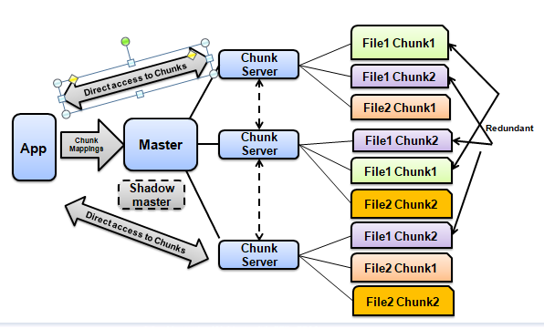
Goals Google File System:HDFS
Google File System (GFS or GoogleFS) is a proprietary distributed file system developed by Google for its own use. It is designed to provide efficient, reliable access to data using large clusters of commodity hardware.

Slide 24
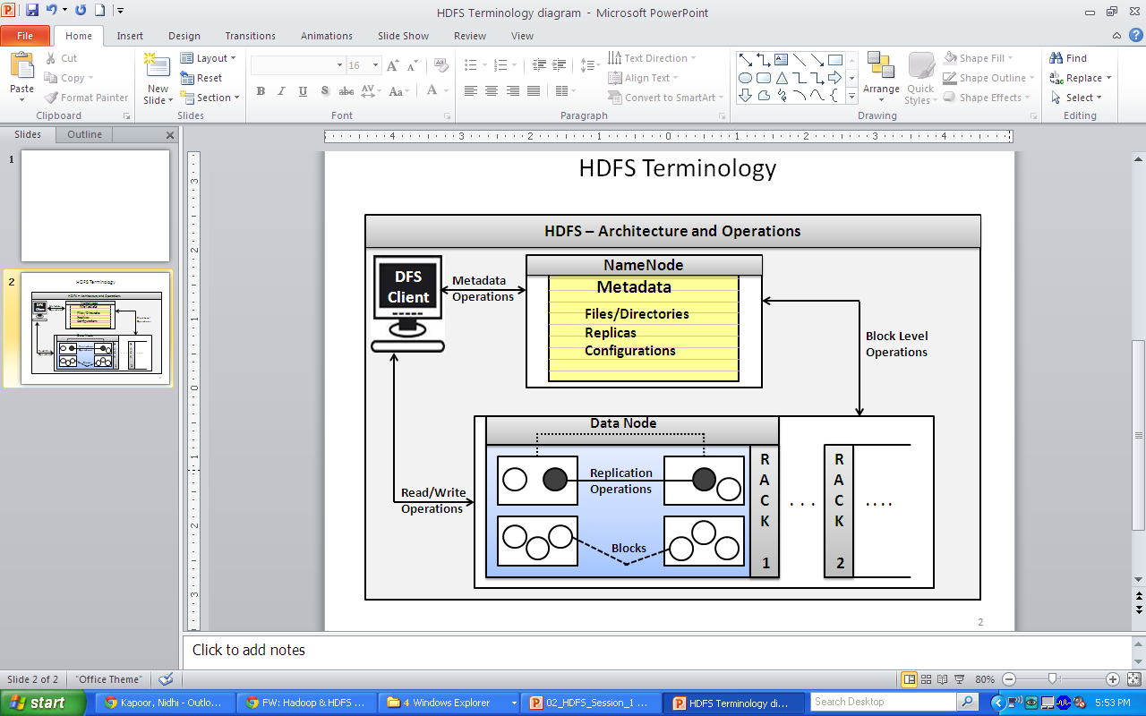
HDFS Terminology
NameNode
DataNode
DFS Client
Files/Directories
Replication
Blocks
Rack-awareness

Slide 25

HDFS Terminology
The NameNode is the centerpiece of an HDFS file system. It keeps the directory tree of all files in the file system, and tracks where across the cluster the file data is kept. It does not store the data of these files itself.
The DataNode is responsible for storing the files in HDFS. It manages the file blocks within the node. It sends information to the NameNode about the files and blocks stored in that node and responds to the NameNode for all filesystem operations

Slide 26
HDFS Terminology
Distributed file System (DFS) is a set of client and server services that allow an organization using Microsoft Windows servers to organize many distributed SMB file shares into a distributed file system
HDFS is designed to reliably store very large files across machines in a large cluster. It stores each file as a sequence of blocks; all blocks in a file except the last block are the same size. The blocks of a file are replicated for fault tolerance. The block size and replication factor are configurable per file. An application can specify the number of replicas of a file. The replication factor can be specified at file creation time and can be changed later. Files in HDFS are write-once and have strictly one writer at any time.
The default data block size of HDFS/hadoop is 64MB. The block size in disk is generally 4KB.

Slide 27
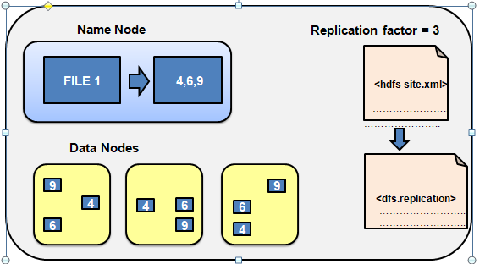
HDFS: NameNode and DataNode
NameNode is the centerpiece of an HDFS file system.
It keeps the directory tree of all files in the file system, and tracks where across the cluster the file data is kept.
It does not store the data of these files itself.
DataNode is responsible for storing the files in HDFS.
It manages the file blocks within the node.
It sends information to the NameNode about the files and blocks stored in that node and responds to the NameNode for all file system operations

Slide 29
Sqoop Overview
What is Sqoop?
Open source software product by Apache Hadoop Foundation and part of Hadoop Ecosystem
Collection of multiple command-line tools to move data between RDBMS and Hadoop
Imports are used to populate tables in Hive or HBase, in addition to HDFS
Exports can be used to put data from Hadoop into an RDBMS
Uses MapReduce for data export and import providing parallel operation in addition to fault tolerance.
Uses JDBC drivers to connect to RDBMS

Slide 30
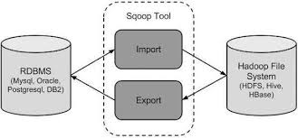
Sqoop Overview
Sqoop is a command-line interface application for transferring data between relational databases and Hadoop.
It supports incremental loads of a single table or a free form SQL query as well as saved jobs which can be run multiple times to import updates made to a database since the last import.
Imports can also be used to populate tables in Hive or HBase.
Exports can be used to put data from Hadoop into a relational database. Sqoop became a top-level Apache project in March 2012.
Apache Sqoop(TM) is a tool designed for efficiently transferring bulk data between Apache Hadoop and structured datastores such as relational databases.

Slide 31
Sqoop Tools
Tools are server commands that administrators can execute on the Sqoop server machine in order to perform various maintenance tasks.
The tool execution will always perform a given task and finish. There are no long running services implemented as tools.
In order to perform the maintenance task each tool is suppose to do, they need to be executed in exactly the same environment as the main Sqoop server.

Slide 32
Sqoop Tools
Available Sqoop Tools
Import Import a table from a database to HDFS
Import-all-tables Import tables from a database to HDFS
Export Export an HDFS directory to a database table
Eval Evaluate a SQL statement and display the results
List-databases List available databases on a server
List-tables List available tables in a database
Codegen Generate code to interact with database records
Create-hive-table Import a table definition into Hive
Version Display version information
Help List available commands

Slide 33
Importing Table from RDBMS
Apache Sqoop can be used to import data from any relational DB into HDFS, Hive or HBase.
The import tool is used to import an individual table from RDBMS to HDFS
Each row from a table corresponds to a separate record in HDFS
Records can be stored in following two formats:
Text files (one record per line)
Binary representation as Avro or Sequence Files

Slide 34
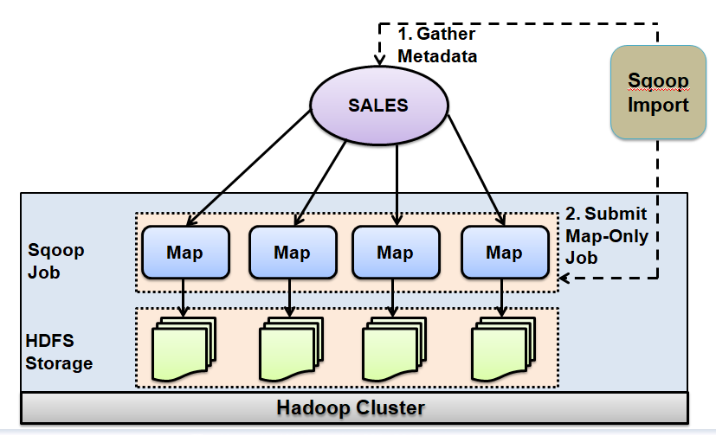
Importing Table from RDBMS

Slide 35
Importing Table from RDBMS
Import data from mysql db to hdfs
sqoop import
--username space_user
--password sp_password
--driver com.mysql.jdbc.Driver
--connect jdbc:mysql://ustrydevmysql1.kih.kmart.com:3306/spaceman
--table BOOK
--hive-import
--target-dir /tmp/tempdir
-m 1

Slide 36
Exporting Data from HDFS
Used to export a set of files from HDFS back to RDBMS
Target table must be present in the database
User can specify record delimiters and field separators present in input file while invoking export

Slide 37
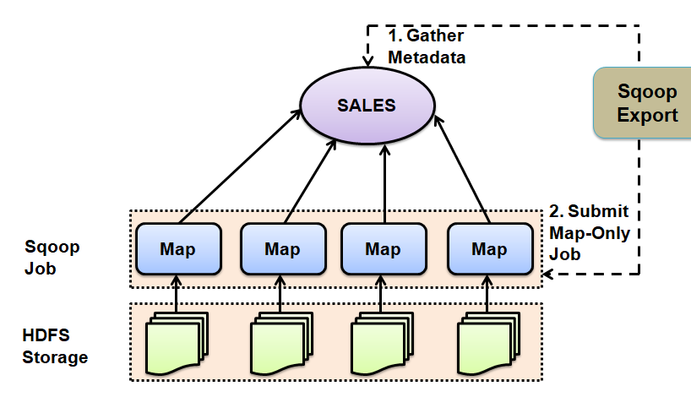
Exporting Data from HDFS
Used to export a set of files from HDFS back to RDBMS
Target table must be present in the database
User can specify record delimiters and field separators present in input file while invoking export

Slide 38
Exporting Data from HDFS
The default operation is to transform data into a set of INSERT statements that inject the records into the database.
Sqoop will generate UPDATE statements In "update mode”. These UPDATE statements substitute existing records in the database.
By default, “update mode” performs UPDATEs only, no INSERTs.
SYNTAX:
$ sqoop export (generic-args) (export-args)

Slide 39
Export Example
to export data back from the HDFS to the RDBMS database
sqoop export
--verbose
--username space_user
--password sp_password
--driver com.mysql.jdbc.Driver
--connect jdbc:mysql://157.241.188.117:3306/spaceman
--table STG_BOOK
--export-dir /tmp/tempdir/books
-m 1

